Slide 1


What is an API?
API means Application Programming Interface. It connects software systems to communicate. APIs are the foundation for modern apps and services.
by Nitish Galat

Slide 2

The "Waiter" Analogy
User Orders
You order from a menu, like using an app interface.
Waiter Acts
The API takes your order to the kitchen (server).
Kitchen Prepares
Kitchen prepares the food (data/service) and gives it to the waiter.
Waiter Returns
The waiter brings your meal, just like API returns data.

Slide 3
How Do APIs Work?
Request & Response
Defined Interface
Example
Data Abstraction
Apps send requests to servers and get responses via APIs.
APIs specify rules for what data can be sent and received.
Weather apps request data from server APIs to show forecasts.
APIs hide complex details, showing only necessary info.

Slide 4
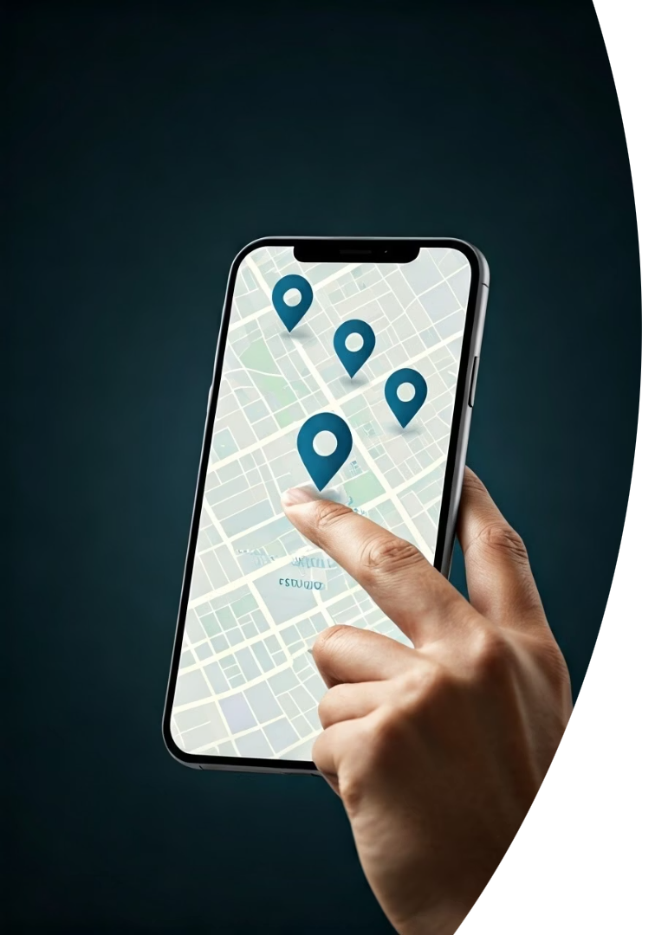
Real-World API Examples
Google Maps
PayPal API
Mobile apps use it to display dynamic locations and directions.
Online stores fetch payment info for secure transactions.
Twitter API
Social apps post updates and retrieve user information.

Slide 5





Types of APIs
Web APIs
Library APIs
OS APIs
Used over the internet; widely common and accessible.
Code from shared libraries developers use in programs.
Enable apps to access hardware and OS features.
Web Service Types
REST
SOAP
GraphQL
WebSocket

Slide 6
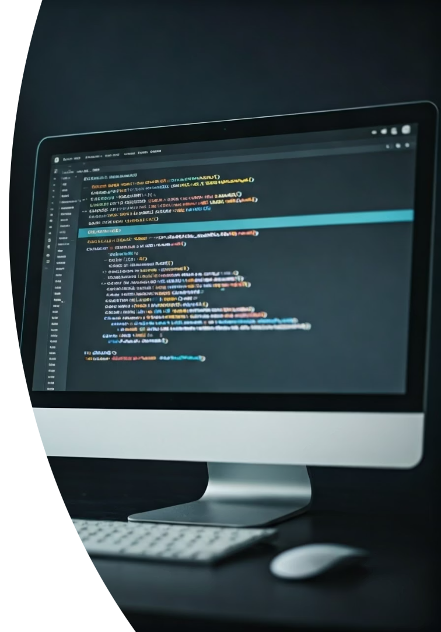



REST, SOAP & Others
REST
Most popular; uses HTTP for simple requests and responses.
SOAP
Uses XML; older, more strict, and heavier protocol.
WebSocket
Enables two-way, real-time communication like chat apps.

Slide 7

Why Are APIs Important?
Protect Logic
Save Time
Share data safely without exposing internal workings.
Enable Ecosystems
Reuse existing code and functions instead of building from scratch.
APIs help diverse services work together seamlessly.

Slide 8



Summary: APIs Make the Digital World Work
Enable Communication
2
Apps share data and grow rapidly in capabilities.
APIs as Waiters
They pass orders between programs efficiently.
1
Everyday Use
3
Using a weather app or paying online means using APIs.

